Slide 1


Embedded Systems Design
Chapter 6: Data Movement Instructions
6.1 The MOV Instruction with Register Mode (RN) Addressing
Brock J. LaMeres, Ph.D.

Slide 2
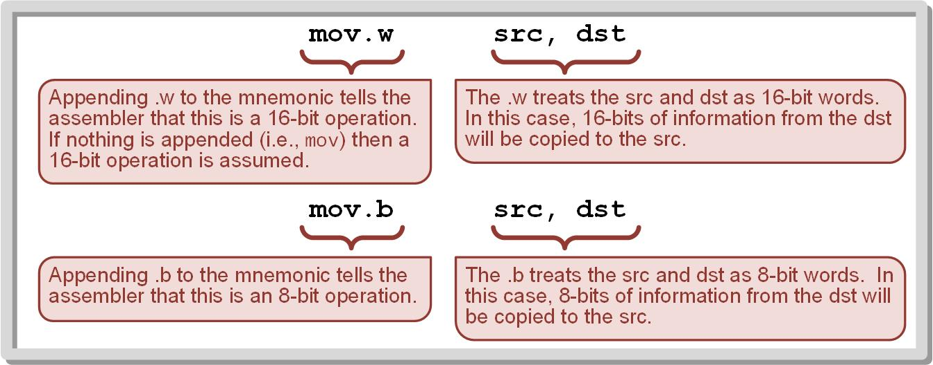
Ch. 6: Data Movement Instructions
The MOV Instruction
MOV – mnemonic; the primary instruction to copy information within the computer system.
src - the location of where the information is to be copied from.
dst – the location of where the information is to be copied to.
The src and dst can either be CPU registers or locations in memory.
Image Courtesy of
Recording Connection of Canada
6.1 The MOV Instruction with Register Mode (RN) Addressing

Slide 3
Ch. 6: Data Movement Instructions
The MOV Instruction
The move instruction performs both 16-bit (.w) and 8-bit (.b) operations. If no extension is used, the instruction is assumed to be a 16-bit operation.
Image Courtesy of
Recording Connection of Canada
6.1 The MOV Instruction with Register Mode (RN) Addressing

Slide 4
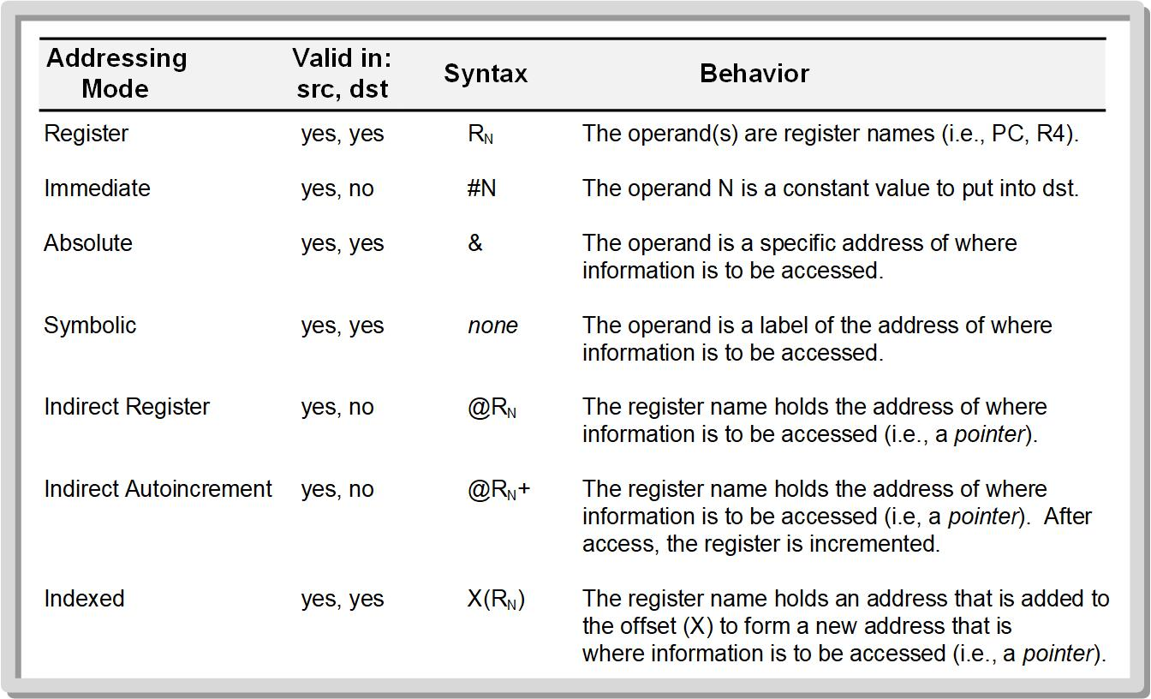
Ch. 6: Data Movement Instructions
Addressing Mode Usage
Image Courtesy of
Recording Connection of Canada
6.7 The MOV Instruction with Indexed Mode (X(RN)) Addressing

Slide 5
Ch. 6: Data Movement Instructions
The MOV Instruction with Register Mode (Rn) Addressing
Addressing mode – the way that the src and dst locations are specified in the operand of an instruction.
Register mode – the operand for either the source and/or destination are CPU registers.
Rn – the syntax to denote register mode addressing int eh MSP430 documentation.
The instruction operates on the data held within the register name provided.
Image Courtesy of
Recording Connection of Canada
6.1 The MOV Instruction with Register Mode (RN) Addressing

Slide 6
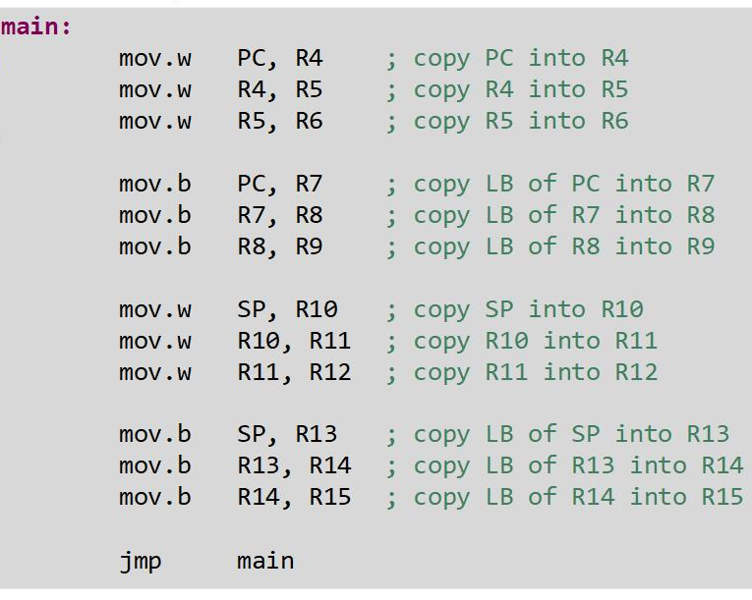
Ch. 6: Data Movement Instructions
Example: Register Mode (Rn) Addressing
Let’s move some information around the CPU registers.
We can use PC and SP as the initial src since they have values.
We’ll watch the information move between registers in the debugger.
6.1 The MOV Instruction with Register Mode (RN) Addressing

Slide 7
Ch. 6: Data Movement Instructions
Example: Register Mode (Rn) Addressing
Step 1: Create a new Empty Assembly-only CCS project titled:
Asm_AddrMode1_Regsiter
Step 2: Type the following
code into the main.asm file
where the comments say
“Main loop here”
6.1 The MOV Instruction with Register Mode (RN) Addressing

Slide 8

Ch. 6: Data Movement Instructions
Example: Register Mode (Rn) Addressing
Step 3: Debug your program. Correct any errors until your program is successfully downloaded.
Step 4: Set a breakpoint before the first instruction
mov.w PC, R4
Step 5: Open the register viewer and expand the Core Registers item to see the CPU registers.
Step 6: Run your program to the breakpoint.
Image Courtesy of https://neodem.wp.horizon.ac.uk/
6.1 The MOV Instruction with Register Mode (RN) Addressing

Slide 9
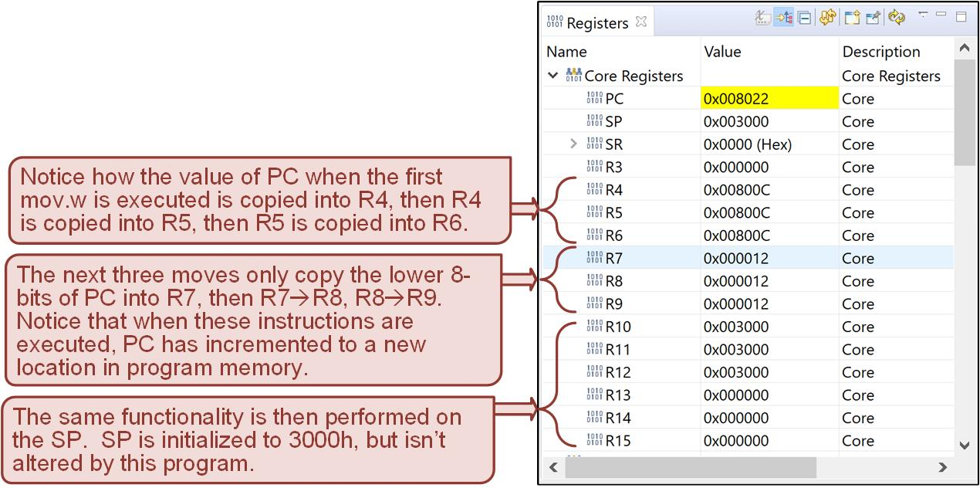
Ch. 6: Data Movement Instructions
Example: Register Mode (Rn) Addressing
Step 7: Step your program through each instruction and observe the data movement in the register viewer.
6.1 The MOV Instruction with Register Mode (RN) Addressing

Slide 10

Embedded Systems Design
Chapter 6: Data Movement Instructions
6.1 The MOV Instruction with Register Mode (RN) Addressing
www.youtube.com/c/DigitalLogicProgramming_LaMeres
Brock J. LaMeres, Ph.D.

Slide 11
Embedded Systems Design
Chapter 6: Data Movement Instructions
6.2 The MOV Instruction with Immediate Mode (#N) Addressing
Brock J. LaMeres, Ph.D.

Slide 12
Ch. 6: Data Movement Instructions
The MOV Instruction with Immediate Mode (#N) Addressing
Immediate Mode – the operand for the src is a numeric constant.
A # is placed in front of the number to indicate it is to be used as a constant.
Immediate mode cannot be used for the dst; it is only valid for the src field.
6.2 The MOV Instruction with Immediate Mode (#N) Addressing

Slide 13
Ch. 6: Data Movement Instructions
Addressing Mode Usage
Image Courtesy of
Recording Connection of Canada
6.7 The MOV Instruction with Indexed Mode (X(RN)) Addressing

Slide 14
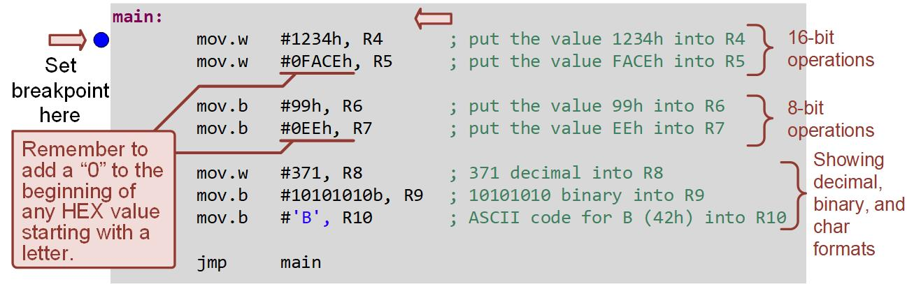
Ch. 6: Data Movement Instructions
Example: Immediate Mode (#N) Addressing
Let’s move some constants into the CPU registers.
We’ll experiment with providing the values in different formats.
We’ll watch the data move using the debugger.
6.2 The MOV Instruction with Immediate Mode (#N) Addressing

Slide 15
Ch. 6: Data Movement Instructions
Example: Immediate Mode (#N) Addressing
Step 1: Create a new Empty Assembly-only CCS project titled:
Asm_AddrMode2_Immediate
Step 2: Type the following code into the main.asm file where the comments say “Main loop here”
6.2 The MOV Instruction with Immediate Mode (#N) Addressing

Slide 16
Ch. 6: Data Movement Instructions
Example: Immediate Mode (#N) Addressing
Step 3: Debug your program. Correct any errors until your program is successfully downloaded.
Step 4: Set a breakpoint before the first instruction
mov.w #1234h, R4
Step 5: Open the register viewer and expand the Core Registers item to see the CPU registers.
Step 6: Run your program to the breakpoint.
Image Courtesy of https://neodem.wp.horizon.ac.uk/
6.2 The MOV Instruction with Immediate Mode (#N) Addressing

Slide 17
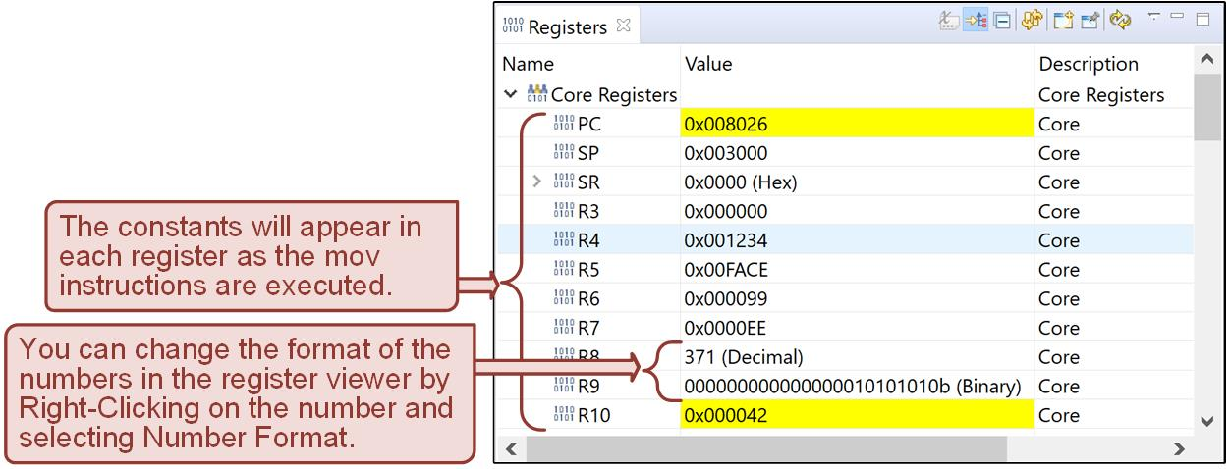
Ch. 6: Data Movement Instructions
Example: Immediate Mode (#N) Addressing
Step 7: Step your program and observe the constants appear in each register.
6.2 The MOV Instruction with Immediate Mode (#N) Addressing

Slide 18
Embedded Systems Design
Chapter 6: Data Movement Instructions
6.2 The MOV Instruction with Immediate Mode (#N) Addressing
www.youtube.com/c/DigitalLogicProgramming_LaMeres
Brock J. LaMeres, Ph.D.

Slide 19
Embedded Systems Design
Chapter 6: Data Movement Instructions
6.3 The MOV Instruction with Absolute Mode (&) Addressing
Brock J. LaMeres, Ph.D.

Slide 20
Ch. 6: Data Movement Instructions
The MOV Instruction with Absolute Mode (&) Addressing
Absolute Mode – the src and/or dst is a 16-bit address value.
The term absolute means that the address provided is the actual address to access and not a variable name or label.
To denote absolute addressing, the value must be preceded by an &.
Image Courtesy of
Recording Connection of Canada
6.3 The MOV Instruction with Absolute Mode (&) Addressing

Slide 21
Ch. 6: Data Movement Instructions
The MOV Instruction with Absolute Mode (&) Addressing
Precede hex values that state with a letter with a “0.”
We will need to use the .data directive to allocate some variable space in data memory.
Image Courtesy of
Recording Connection of Canada
6.3 The MOV Instruction with Absolute Mode (&) Addressing

Slide 22
Ch. 6: Data Movement Instructions
Addressing Mode Usage
Image Courtesy of
Recording Connection of Canada
6.7 The MOV Instruction with Indexed Mode (X(RN)) Addressing

Slide 23
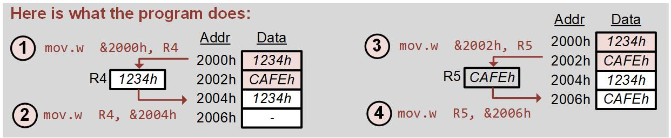
Ch. 6: Data Movement Instructions
Example: Absolute Mode (&) Addressing
Let’s define some constants in data memory.
Let’s also reserve some space in data memory.
We’ll then move the constant values from one address in memory to the reserved address using their absolute addresses.
We’ll watch the movement using the Memory Browser in the debugger.
Image Courtesy of
Recording Connection of Canada
6.3 The MOV Instruction with Absolute Mode (&) Addressing

Slide 24
Ch. 6: Data Movement Instructions
Example: Absolute Mode (&) Addressing
Step 1: Create a new Empty Assembly-only CCS project titled:
Asm_AddrMode3_Absolute
Step 2: We are going to create a main program and also initialize some space in memory that we can access. We will put that .data section directly after the main program code. Type the following code into the main.asm file where the comments say “Main loop here”
Image Courtesy of
Recording Connection of Canada
6.3 The MOV Instruction with Absolute Mode (&) Addressing

Slide 25
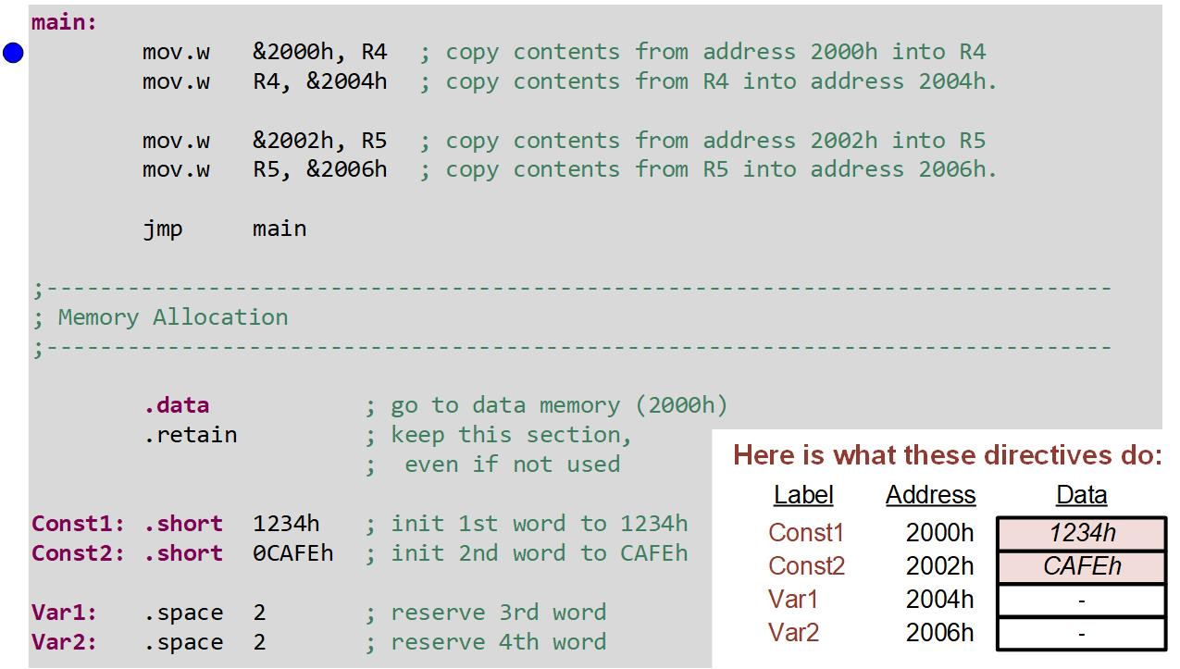
Ch. 6: Data Movement Instructions
Example: Absolute Mode (&) Addressing
Image Courtesy of
Recording Connection of Canada
6.3 The MOV Instruction with Absolute Mode (&) Addressing

Slide 26
Ch. 6: Data Movement Instructions
Example: Absolute Mode (&) Addressing
Step 3: Debug your program. Fix errors as needed.
Step 4: Set a breakpoint before the first instruction
mov.w &2000h, R4
Step 5: Open the register viewer and memory browser. Inspect the memory starting at 2000h.
Image Courtesy of https://neodem.wp.horizon.ac.uk/
Image Courtesy of
Recording Connection of Canada
6.3 The MOV Instruction with Absolute Mode (&) Addressing

Slide 27
Ch. 6: Data Movement Instructions
Example: Absolute Mode (&) Addressing
Step 6: Run & step your program while observing the registers and memory.
Image Courtesy of
Recording Connection of Canada
6.3 The MOV Instruction with Absolute Mode (&) Addressing

Slide 28
Embedded Systems Design
Chapter 6: Data Movement Instructions
6.3 The MOV Instruction with Absolute Mode (&) Addressing
www.youtube.com/c/DigitalLogicProgramming_LaMeres
Brock J. LaMeres, Ph.D.

Slide 29
Embedded Systems Design
Chapter 6: Data Movement Instructions
6.4 The MOV Instruction with Symbolic Mode Addressing
Brock J. LaMeres, Ph.D.

Slide 30
Ch. 6: Data Movement Instructions
The MOV Instruction with Symbolic Mode Addressing
Symbolic Mode – allows the use of address labels as operands.
In symbolic mode, the address label is simply inserted in either the src or dst fields without any preceding indicator.
If the assembler sees any non-numeric character in an operand, it treats it as an address label.
Supports labels for 16-bit addresses so it can only access memory between 0 → 65,535 or 0000h → FFFFh.
Image Courtesy of
Recording Connection of Canada
6.4 The MOV Instruction with Symbolic Mode Addressing

Slide 31
Ch. 6: Data Movement Instructions
Addressing Mode Usage
Image Courtesy of
Recording Connection of Canada
6.7 The MOV Instruction with Indexed Mode (X(RN)) Addressing

Slide 32
Ch. 6: Data Movement Instructions
Example: Symbolic Mode (&) Addressing
Let’s define some constants in data memory with labels.
Let’s also reserve some space in data memory with labels.
We’ll then move the constant values from one address in memory to the reserved address using their labels.
We’ll watch the movement using the Memory Browser in the debugger.
6.4 The MOV Instruction with Absolute Mode (&) Addressing

Slide 33
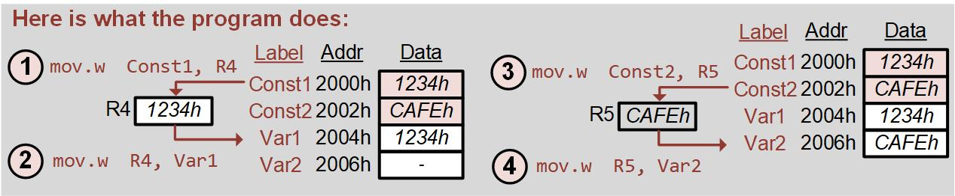
Ch. 6: Data Movement Instructions
Example: Symbolic Mode Addressing
Step 1: Create a new Empty Assembly-only CCS project titled:
Asm_AddrMode4_Symbolic
Step 2: We are going to create a main program and also initialize some space in memory that we can access. We will put that .data section directly after the main program code. Type the following code into the main.asm file where the comments say “Main loop here”
6.4 The MOV Instruction with Symbolic Mode Addressing

Slide 34
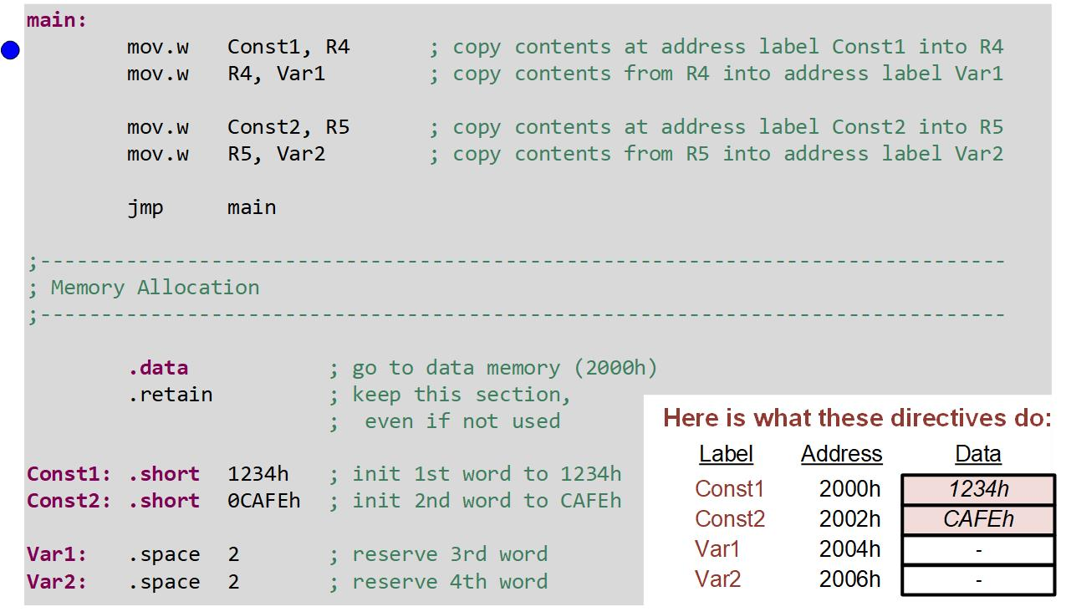
Ch. 6: Data Movement Instructions
Example: Symbolic Mode Addressing
Image Courtesy of
Recording Connection of Canada
6.4 The MOV Instruction with Symbolic Mode Addressing

Slide 35
Ch. 6: Data Movement Instructions
Example: Symbolic Mode Addressing
Step 3: Debug your program. Fix errors as needed.
Step 4: Set a breakpoint before the first instruction
mov.w Const1, R4
Step 5: Open the register viewer and memory browser. Inspect the memory starting at 2000h.
Image Courtesy of https://neodem.wp.horizon.ac.uk/
Image Courtesy of
Recording Connection of Canada
6.4 The MOV Instruction with Symbolic Mode Addressing

Slide 36
Ch. 6: Data Movement Instructions
Example: Symbolic Mode Addressing
Step 6: Run & step your program while observing the registers and memory.
Image Courtesy of
Recording Connection of Canada
6.4 The MOV Instruction with Symbolic Mode Addressing

Slide 37
Embedded Systems Design
Chapter 6: Data Movement Instructions
6.4 The MOV Instruction with Symbolic Mode Addressing
www.youtube.com/c/DigitalLogicProgramming_LaMeres
Brock J. LaMeres, Ph.D.

Slide 38

Embedded Systems Design
Chapter 6: Data Movement Instructions
6.5 The MOV Instruction with Indirect Register Mode (@RN) Addressing
Image Courtesy of
Recording Connection of Canada
Brock J. LaMeres, Ph.D.

Slide 39
Ch. 6: Data Movement Instructions
The MOV Instruction with Indirect Register Mode (@Rn) Addressing
Indirect Register Mode – a CPU register is used to provide the address of where the info to be accessed is stored.
Provides the address in a way that the CPU register can be modified by subsequent instructions.
Image Courtesy of
Recording Connection of Canada
6.5 The MOV Instruction with Indirect Register Mode (@RN) Addressing

Slide 40
Ch. 6: Data Movement Instructions
The MOV Instruction with Indirect Register Mode (@Rn) Addressing
To indicate that a register is to be used as an address pointer, an @ is inserted before the register name.
Indirect register mode is only valid in the src of an instruction.
This is the same concept as a pointer in the language C.
Image Courtesy of
Recording Connection of Canada
6.5 The MOV Instruction with Indirect Register Mode (@RN) Addressing

Slide 41
Ch. 6: Data Movement Instructions
The MOV Instruction with Indirect Register Mode (@Rn) Addressing
Provides a way to access blocks of memory by incrementing the address pointer in a loop.
Image Courtesy of
Recording Connection of Canada
6.5 The MOV Instruction with Indirect Register Mode (@RN) Addressing

Slide 42
Ch. 6: Data Movement Instructions
Addressing Mode Usage
Image Courtesy of
Recording Connection of Canada
6.7 The MOV Instruction with Indexed Mode (X(RN)) Addressing

Slide 43
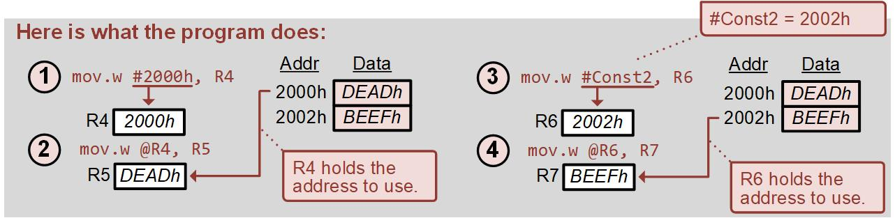
Ch. 6: Data Movement Instructions
Example: Indirect Register Mode (@Rn) Addressing
Let’s define some constants in data memory with labels.
Let’s also reserve some space in data memory with labels.
We’ll then move the constant values from one address in memory to the reserved address using indirect register mode.
We’ll watch the movement using the debugger.
6.5 The MOV Instruction with Indirect Register Mode (@RN) Addressing

Slide 44
Ch. 6: Data Movement Instructions
Example: Indirect Register Mode (@Rn) Addressing
Step 1: Create a new Empty Assembly-only CCS project titled:
Asm_AddrMode5_Indirect_Register
Step 2: We are going to create a main program and also initialize some space in memory that we can access. We will put that .data section directly after the main program code. Type the following code into the main.asm file where the comments say “Main loop here”
Image Courtesy of https://neodem.wp.horizon.ac.uk/
Image Courtesy of
Recording Connection of Canada
6.5 The MOV Instruction with Indirect Register Mode (@RN) Addressing

Slide 45
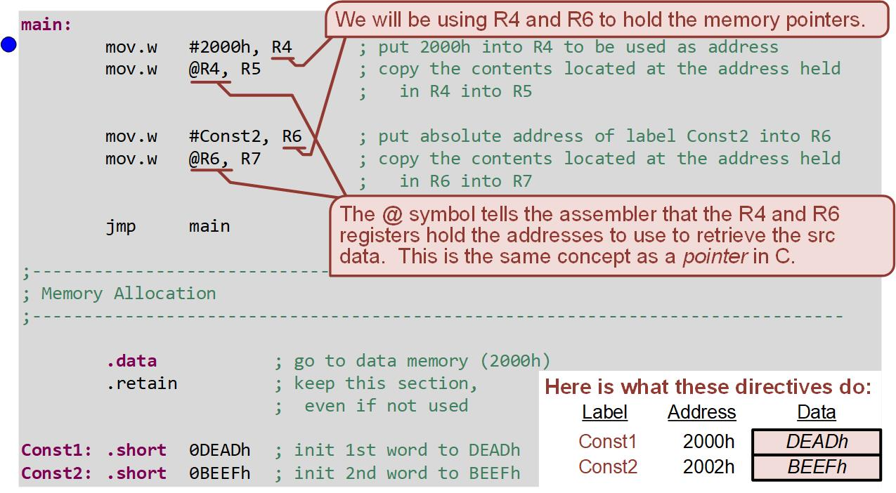
Ch. 6: Data Movement Instructions
Example: Indirect Register Mode (@Rn) Addressing
Image Courtesy of
Recording Connection of Canada
6.5 The MOV Instruction with Indirect Register Mode (@RN) Addressing

Slide 46
Ch. 6: Data Movement Instructions
Example: Indirect Register Mode (@Rn) Addressing
Step 3: Debug your program. Fix errors as needed.
Step 4: Set a breakpoint before the first instruction
mov.w #2000h, R4
Step 5: Open the register viewer and memory browser. Inspect the memory starting at 2000h.
Image Courtesy of https://neodem.wp.horizon.ac.uk/
Image Courtesy of
Recording Connection of Canada
6.5 The MOV Instruction with Indirect Register Mode (@RN) Addressing

Slide 47
Ch. 6: Data Movement Instructions
Example: Indirect Register Mode (@Rn) Addressing
Step 6: Run & step your program while observing the registers and memory.
Image Courtesy of
Recording Connection of Canada
6.5 The MOV Instruction with Indirect Register Mode (@RN) Addressing

Slide 48
Embedded Systems Design
Chapter 6: Data Movement Instructions
6.5 The MOV Instruction with Indirect Register Mode (@RN) Addressing
www.youtube.com/c/DigitalLogicProgramming_LaMeres
Brock J. LaMeres, Ph.D.

Slide 49
Embedded Systems Design
Chapter 6: Data Movement Instructions
6.6 The MOV Instruction with Indirect Autoincrement Mode (@RN+) Addressing
Brock J. LaMeres, Ph.D.

Slide 50
Ch. 6: Data Movement Instructions
The MOV Instruction with Indirect Autoincrement Mode (@Rn+) Addressing
Indirect Autoincrement Mode – the pointing register is automatically incremented after the completion of the instruction.
The pointing register can be incremented by 1 or 2 depending on the type of the size of the operation dictated by .w and .b .
Only allowed in the src
Image Courtesy of
Recording Connection of Canada
6.6 The MOV Instruction with Indirect Autoincrement Mode (@RN+) Addressing

Slide 51
Ch. 6: Data Movement Instructions
Addressing Mode Usage
Image Courtesy of
Recording Connection of Canada
6.7 The MOV Instruction with Indexed Mode (X(RN)) Addressing

Slide 52
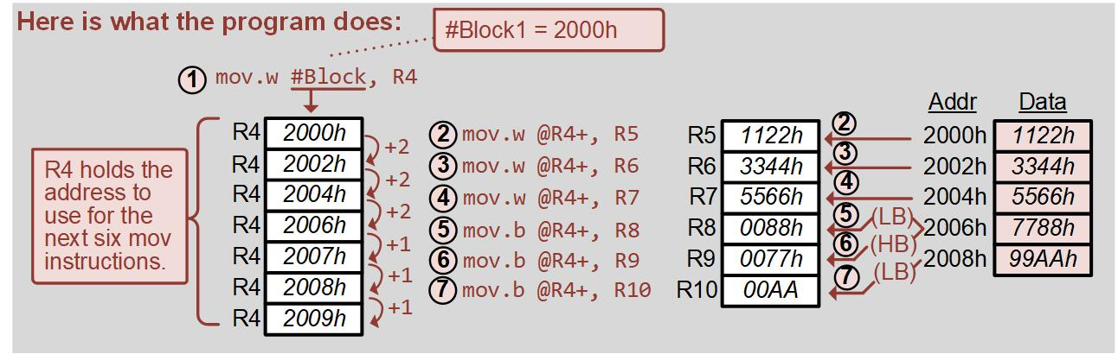
Ch. 6: Data Movement Instructions
Example: Indirect Autoincrement Mode (@Rn+) Addressng
Let’s define a block of constants in memory.
Then we’ll move their values into CPU registers using Indirect Autoincrement Mode to automatically provide the address.
We’ll watch the data move in the debugger.
Image Courtesy of
Recording Connection of Canada
6.6 The MOV Instruction with Indirect Autoincrement Mode (@RN+) Addressing

Slide 53
Ch. 6: Data Movement Instructions
Example: Indirect Autoincrement Mode (@Rn+) Addressng
Step 1: Create a new Empty Assembly-only CCS project titled:
Asm_AddrMode6_Indirect_Autoincrement
Step 2: Type the following code into the main.asm file where the comments say “Main loop here”
Image Courtesy of https://neodem.wp.horizon.ac.uk/
Image Courtesy of
Recording Connection of Canada
6.6 The MOV Instruction with Indirect Autoincrement Mode (@RN+) Addressing

Slide 54
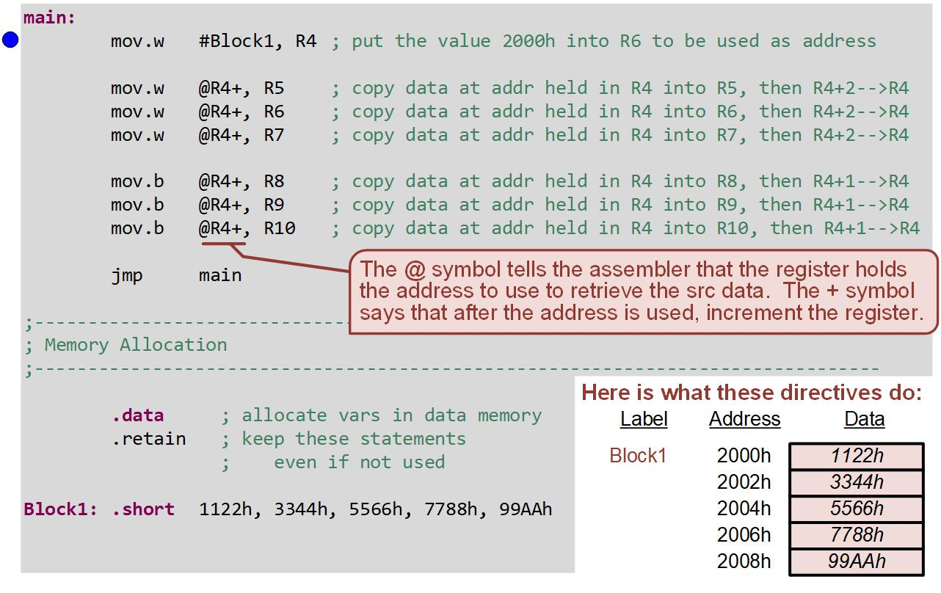
Ch. 6: Data Movement Instructions
Example: Indirect Autoincrement Mode (@Rn+) Addressng
Image Courtesy of
Recording Connection of Canada
6.6 The MOV Instruction with Indirect Autoincrement Mode (@RN+) Addressing

Slide 55
Ch. 6: Data Movement Instructions
Example: Indirect Autoincrement Mode (@Rn+) Addressng
Step 3: Debug your program. Fix errors as needed.
Step 4: Set a breakpoint before the first instruction
mov.w #Block1, R4
Step 5: Open the register viewer and memory browser. Inspect the memory starting at 2000h.
Image Courtesy of https://neodem.wp.horizon.ac.uk/
Image Courtesy of
Recording Connection of Canada
6.6 The MOV Instruction with Indirect Autoincrement Mode (@RN+) Addressing

Slide 56
Ch. 6: Data Movement Instructions
Example: Indirect Autoincrement Mode (@Rn+) Addressng
Step 6: Run & step your program while observing the registers and memory.
Image Courtesy of
Recording Connection of Canada
6.6 The MOV Instruction with Indirect Autoincrement Mode (@RN+) Addressing

Slide 57
Embedded Systems Design
Chapter 6: Data Movement Instructions
6.6 The MOV Instruction with Indirect Autoincrement Mode (@RN+) Addressing
www.youtube.com/c/DigitalLogicProgramming_LaMeres
Brock J. LaMeres, Ph.D.

Slide 58
Embedded Systems Design
Chapter 6: Data Movement Instructions
6.7 The MOV Instruction with Indexed Mode (X(RN)) Addressing
Image Courtesy of
Recording Connection of Canada
Brock J. LaMeres, Ph.D.

Slide 59
Ch. 6: Data Movement Instructions
The MOV Instruction with Indexed Mode (X(Rn)) Addressing
Indexed Mode – allows a numeric constant to be added to the contents of the register.
Offset – numeric constant; 16-bit, signed number.
Similar to indirect register made in that a register name is provided that holds the address of where to access the information.
Image Courtesy of
Recording Connection of Canada
6.7 The MOV Instruction with Indexed Mode (X(RN)) Addressing

Slide 60
Ch. 6: Data Movement Instructions
The MOV Instruction with Indexed Mode (X(Rn)) Addressing
The syntax to indicate indexed register mode is to put the name of the register in parenthesis () with the numeric constant in front.
Works in both the src and dst fields.
Image Courtesy of
Recording Connection of Canada
6.7 The MOV Instruction with Indexed Mode (X(RN)) Addressing

Slide 61
Ch. 6: Data Movement Instructions
Addressing Mode Usage
Image Courtesy of
Recording Connection of Canada
6.7 The MOV Instruction with Indexed Mode (X(RN)) Addressing

Slide 62
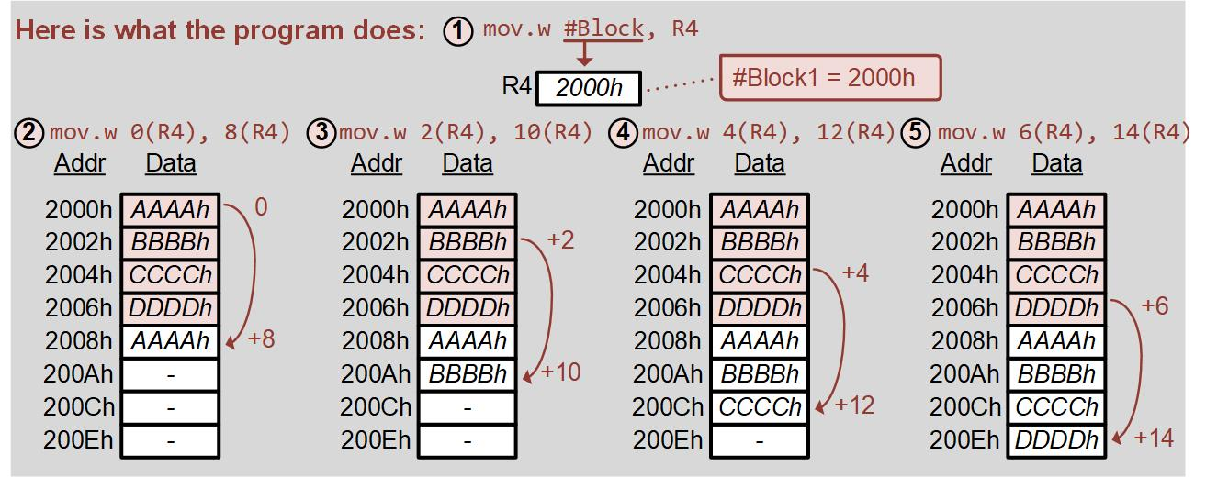
Ch. 6: Data Movement Instructions
Example: Indexed Mode (X(Rn)) Addressing
Let’s initialize a block of constants in memory.
Let’s reserve a block of memory.
We’ll then copy the constants into the open space using knowledge about the address offset with indexed mode.
Image Courtesy of
Recording Connection of Canada
6.7 The MOV Instruction with Indexed Mode (X(RN)) Addressing

Slide 63
Ch. 6: Data Movement Instructions
Example: Indexed Mode (X(Rn)) Addressing
Step 1: Create a new Empty Assembly-only CCS project titled:
Asm_AddrMode7_Indexed
Step 2: Type the following code into the main.asm file where the comments say “Main loop here”
Image Courtesy of https://neodem.wp.horizon.ac.uk/
Image Courtesy of
Recording Connection of Canada
6.7 The MOV Instruction with Indexed Mode (X(RN)) Addressing

Slide 64
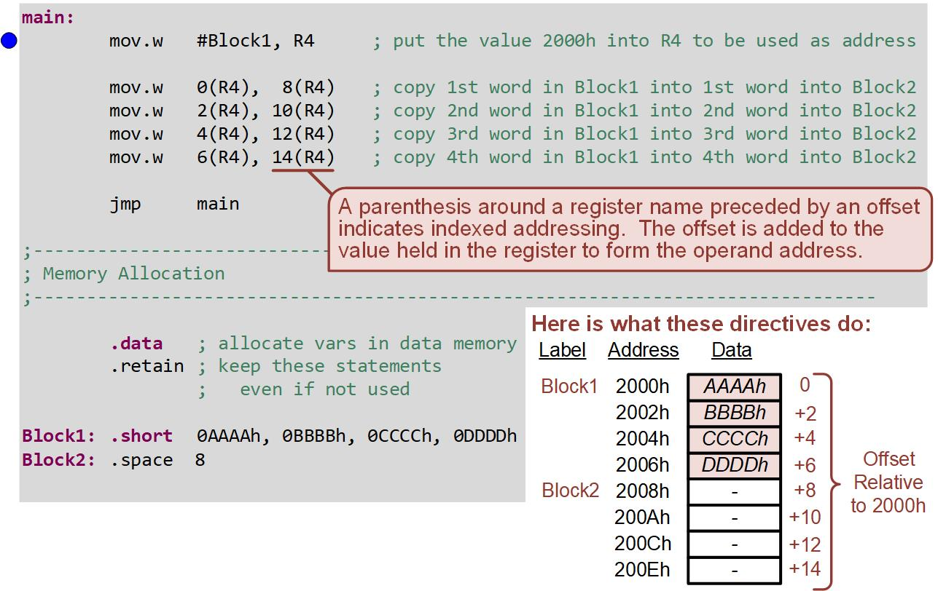
Ch. 6: Data Movement Instructions
Example: Indexed Mode (X(Rn)) Addressing
Image Courtesy of
Recording Connection of Canada
6.7 The MOV Instruction with Indexed Mode (X(RN)) Addressing

Slide 65
Ch. 6: Data Movement Instructions
Example: Indexed Mode (X(Rn)) Addressing
Step 3: Debug your program. Fix errors as needed.
Step 4: Set a breakpoint before the first instruction
mov.w #Block1, R4
Step 5: Open the register viewer and memory browser. Inspect the memory starting at 2000h.
Image Courtesy of https://neodem.wp.horizon.ac.uk/
Image Courtesy of
Recording Connection of Canada
6.7 The MOV Instruction with Indexed Mode (X(RN)) Addressing

Slide 66
Ch. 6: Data Movement Instructions
Example: Indexed Mode (X(Rn)) Addressing
Step 6: Run & step your program while observing the registers and memory.
Image Courtesy of
Recording Connection of Canada
6.7 The MOV Instruction with Indexed Mode (X(RN)) Addressing

Slide 67
Embedded Systems Design
Chapter 6: Data Movement Instructions
6.7 The MOV Instruction with Indexed Mode (X(RN)) Addressing
www.youtube.com/c/DigitalLogicProgramming_LaMeres
Image Courtesy of
Recording Connection of Canada
Brock J. LaMeres, Ph.D.

